Slide 1
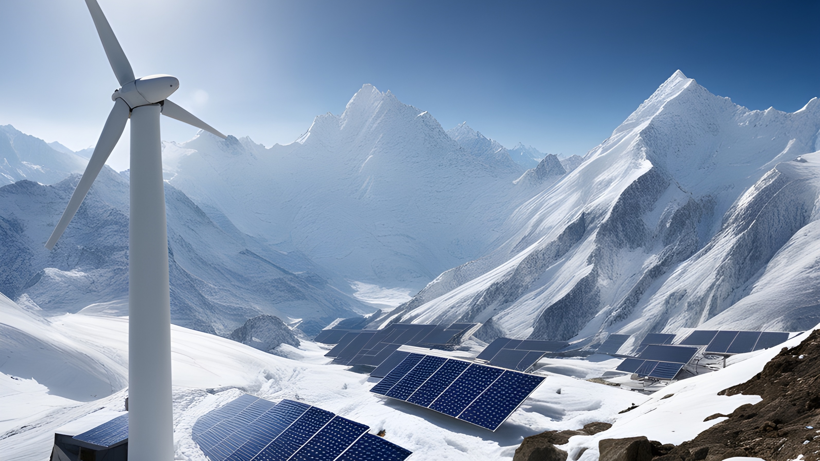
SEED HIMALAYA ENERGY SYSTEMS
Full-Stack Development of a User-Friendly Web-Based Interface for Optimizing Mini-Grids in Rural Himalayan Communities
Angelo Stefanini, Athul Thattarkandy, Julian Machnitzke, Gayana Rajendra Reddy, Meidyana Rayana, Roy Kadavilparambil Cherian
Notes:
Imagine living in a place where electricity is a luxury, where the simple act of turning on a light or charging a phone is a daily challenge. This is the reality for many remote mountain communities in the Himalayas. Today, we are aiming to change this reality by bringing sustainable energy solutions to these communities. Our goal is not just to provide electricity but to create decentralized renewable energy systems that are technologically advanced, socially inclusive, and economically viable.

Slide 2

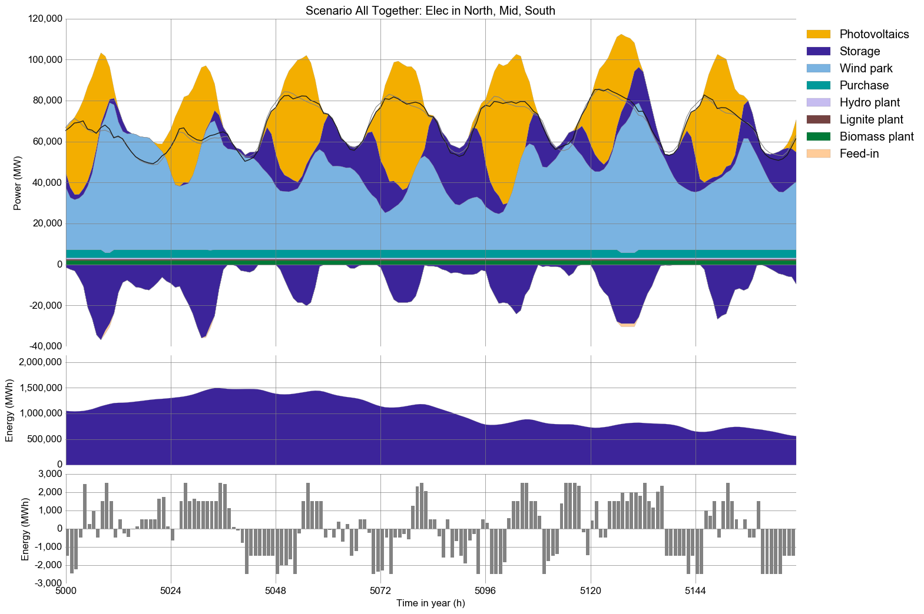
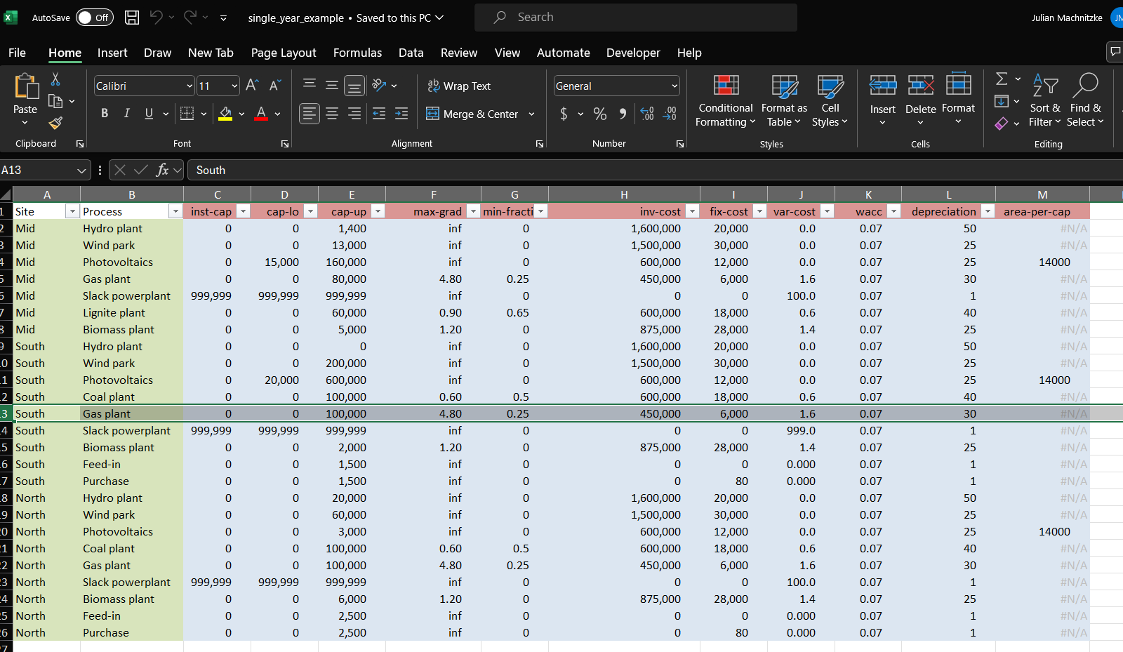
INTRODUCTION
URBS is a linear optimization framework designed for optimizing energy systems
Overview
Methodology
Summary
Notes:
URBS is a linear optimization framework designed for optimizing energy systems, and it was developed here at the chair. And I assume that most of the people here would already know about it. Nevertheless, this plot was created by URBS showing the optimized electricity generation and storage levels. However, running URBS can be a bit complicated. As you can see on the right, URBS requires this complex Excel file as an input which necessitates expert-level knowledge on the topic.

Slide 3
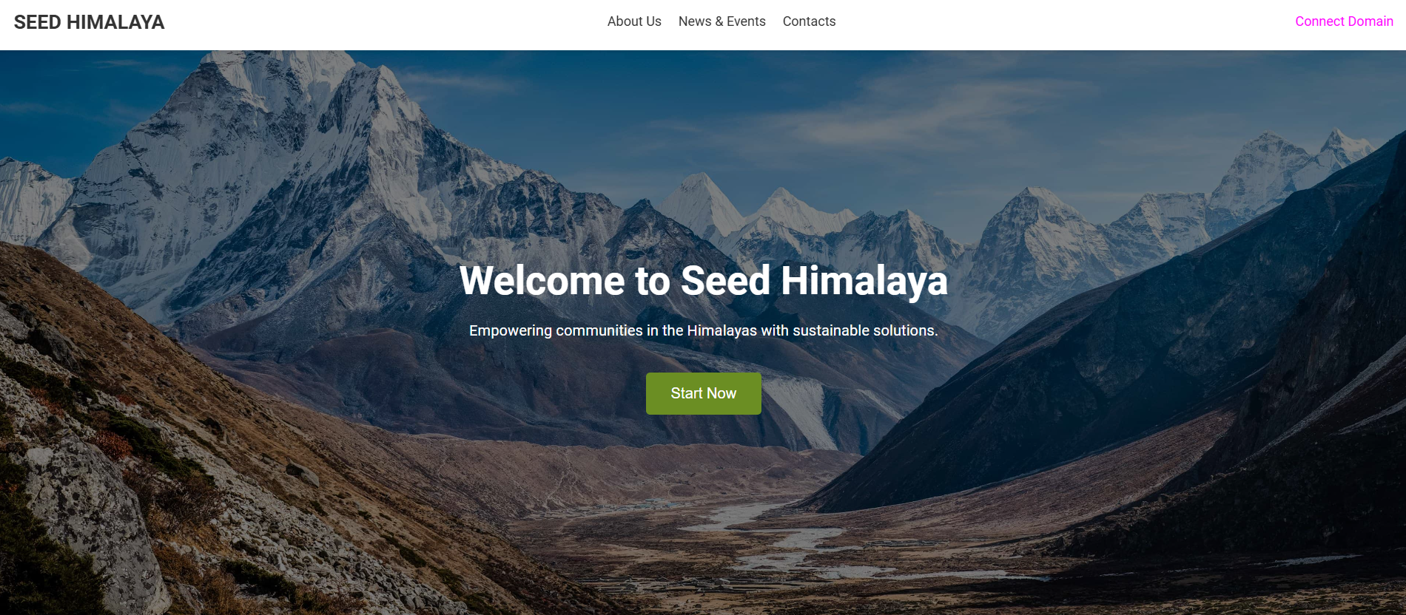
INTRODUCTION
Objectives:
Run URBS on Website
User friendly
Data Collection
Northern India/ Himalaya
Overview
Methodology
Summary
Notes:
So, our goal was to simplify the data required for URBS and enable inexperienced users to run URBS from a website with simple inputs and drag-and-drop options. The next task was to collect the data specifically for Northern India/Himalayas.

Slide 4
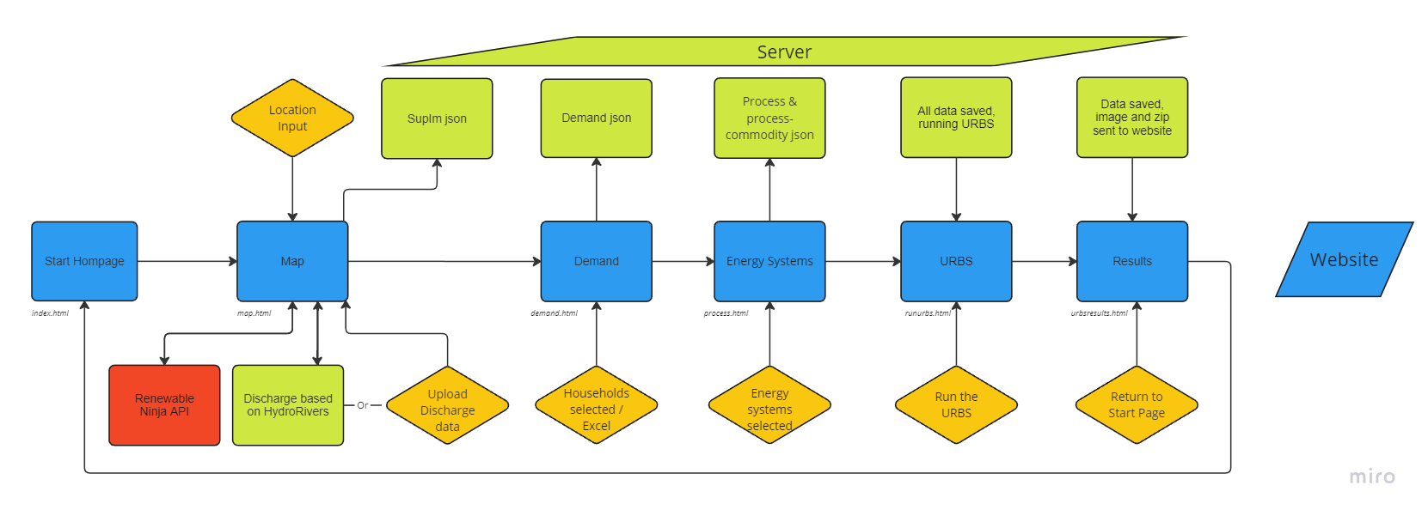
WEBSITE LOGIC
Overview
Methodology
Summary
Notes:
On the server part (green) the json files from the website (blue) are received and transformed so that the URBS algorithm con properly read in the data
Data from Renewable Ninjas is requested via an API (red)
User input (grey) comprises the location and optionally, timeseries for demand and discharge
After URBS has run successfully, the results are again uploaded to the Website

Slide 5
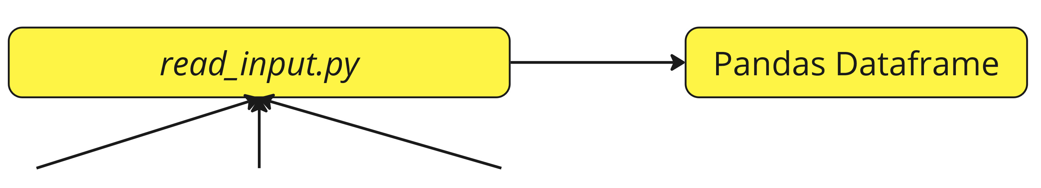
READ JSONS
Overview
Methodology
Summary
Notes:
On the server part (green) the json files from the website (blue) are received and transformed so that the URBS algorithm con properly read in the data
Data from Renewable Ninjas is requested via an API (red)
User input (grey) comprises the location and optionally, timeseries for demand and discharge
After URBS has run successfully, the results are again uploaded to the Website

Slide 6
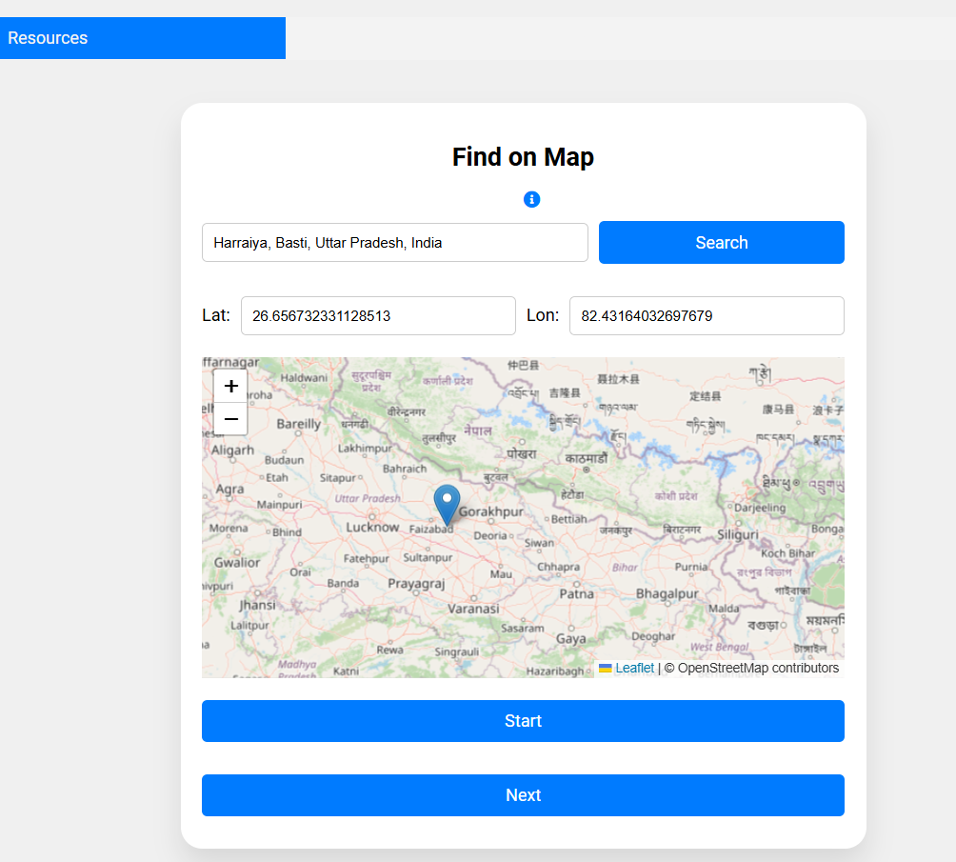
SUPIM DATA FROM RENEWABLE NINJA
Acquire solar and wind energy data from the Renewable ninja website, which involved two sub-steps:
Design an HTML file for the map layout, enabling users to search for locations or directly select them on a map to obtain data from Renewable Ninja.
Write a python code to retrieve data from the renewable ninja web site based on the user-selected location.
Overview
Methodology
Summary
Notes:
Thanks Julian,
One critical commodity type in URBS is SupIm. We utilised renewable ninja website to obtain this solar and wind energy data.
This involved two key steps. Firstly, we designed an HTML file, as you can see on the right, where users can input a location as text to search for it or simply drag the marker on the map to update the location. Once the data is retrieved, download buttons for the photovoltaic (PV) and wind data files appear. Secondly, we wrote a Python code to fetch data from Renewable Ninja based on the user's chosen location.

Slide 7
SUPIM FLOWCHART
Renewable
Ninja SUpIM
Overview
Methodology
Summary
Notes:
This is the renewable ninja part, Upon receiving the coordinates, the server authenticates API calls to the "renewables.ninja" service to fetch solar and wind data for the specified location. They are then processed into JSON files and saved in a designated 'uploads' directory on the server.
I would now like to hand it over to Julian.

Slide 8
HYDRO SUPIM
Hydro SUpIM
Overview
Methodology
Summary

Slide 9
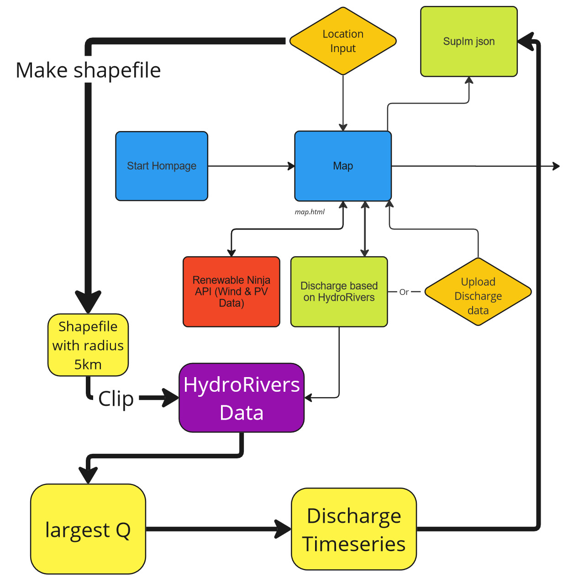
HYDRO DATA
Overview
Methodology
Summary

Slide 10
ELECTRICAL DEMAND INPUT
Urbs evaluates various technologies for production, storage, and transmission, ensuring that energy demand requirements are met at the lowest possible cost.
Overview
Methodology
Summary
Notes:
Thank you, Julian. At this point, we can move on to the second major part of the website's architecture, which is related to electrical demand. As a programming framework to optimize energy systems, URBS relies on the precise specification of demand, representing the system's time-specific energy needs. The model's primary objective is to determine the most cost-effective solution to meet these demands.

Slide 11
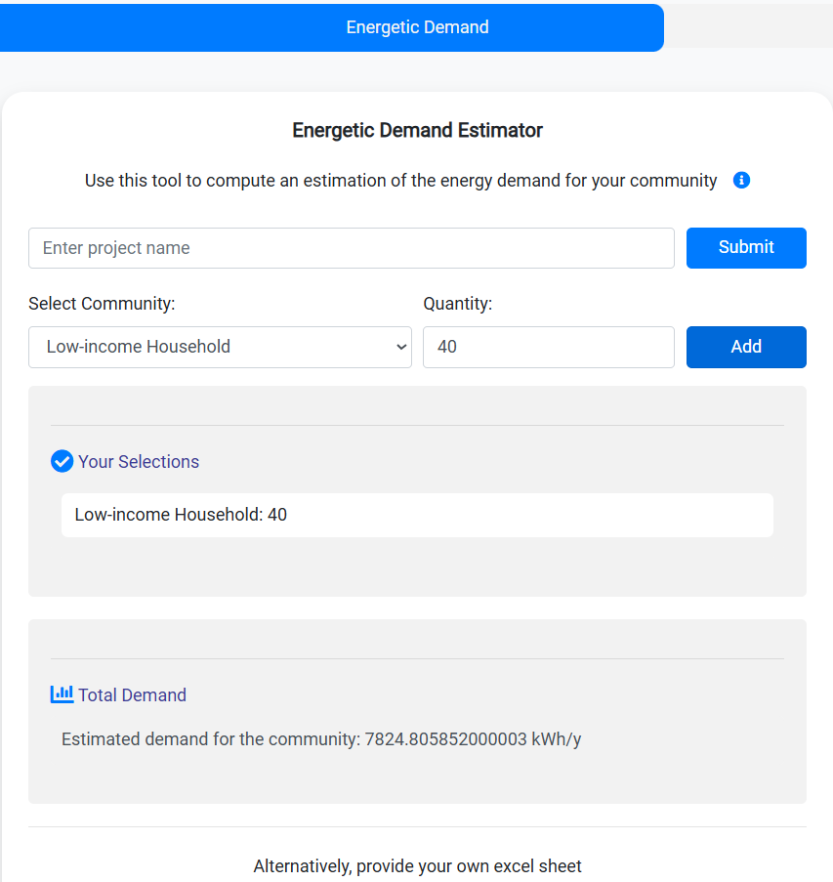
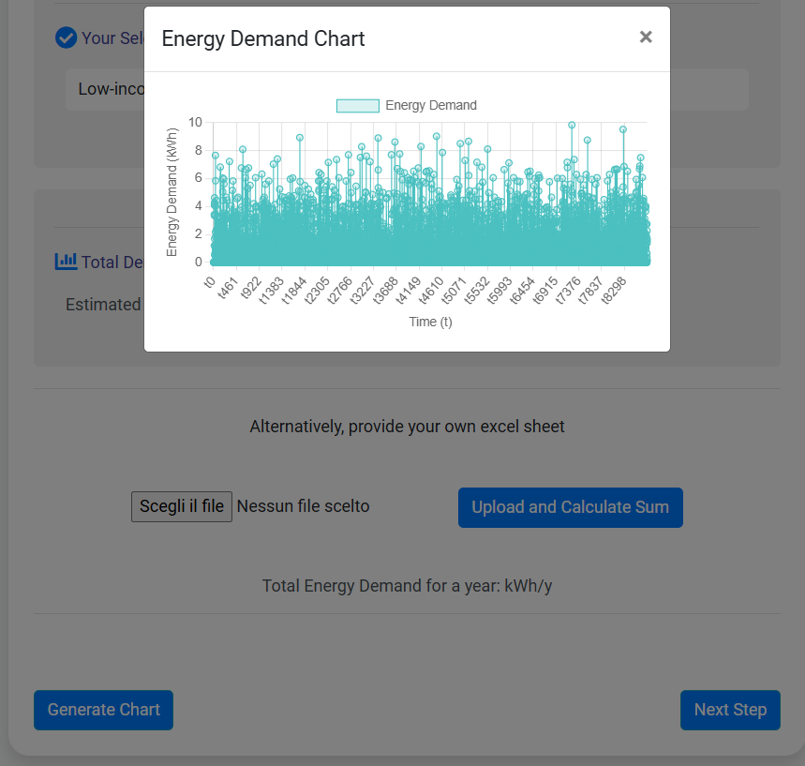
FRONTEND USER INTERFACE
Create a model of a community by specifying the type and number of existing structures.
Alternatively, add any available data from an Excel file.
Get real-time yearly energy demand for the community and visualize it with interactive graphs.
Overview
Methodology
Summary
Notes:
Our platform should, therefore, be able to generate an input regarding the demand for URBS. This means that not only should the user be able to upload their own data if available, but our tool should also provide the option to estimate the demand of a community by stating its general characteristics and size.
As it is currently implemented, the website allows the user to select the type and kind of structures available at their location and get an estimation of total energy consumption in kWh/year. There is also the option to plot the demand chart over time. Alternatively, the user can upload their own Excel file. What happens in the backend is that we send a JSON file with all hourly demand data to the URBS input folder.

Slide 12
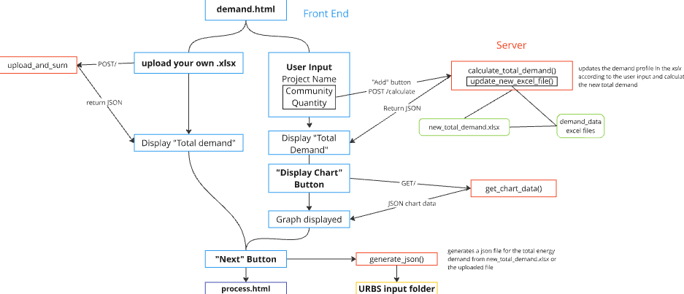
GENERAL FUNCTIONING OF DEMAND TOOL
Flask serves as the foundation of the whole application, managing routing, request processing, and data handling.
.
The file `new_total_demand.xlsx` is updated in real-time based on the user's selections using demand data, which contains all the information on the annual energy profiles for the structures under examination.
Overview
Methodology
Summary
Notes:
Delving a bit into the backend of the platform, without going too in-depth due to time limitations, the backend revolves around updating the new total demand Excel files with data based on user input and coming from the demand database, which stems from Roy and Gayana's literary analysis as explained in detail later.

Slide 13


PROCESS AND PROCESS-COMMODITY
Overview
Methodology
Summary
Notes:
The next step of the architecture of the webiste is represented by the process input, which are represents the enrgy conversion technologies, which converts commodities from one kind to the other and are characterised by two kind of paramteres, economical and technoloigcal.

Slide 14
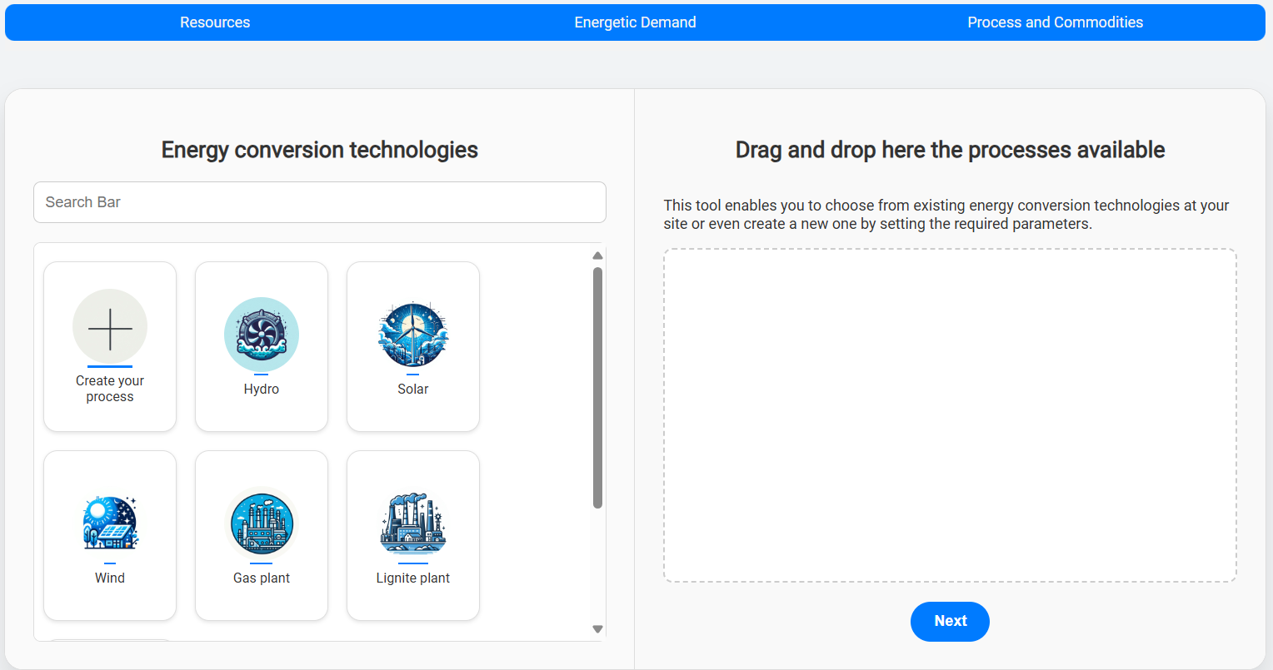
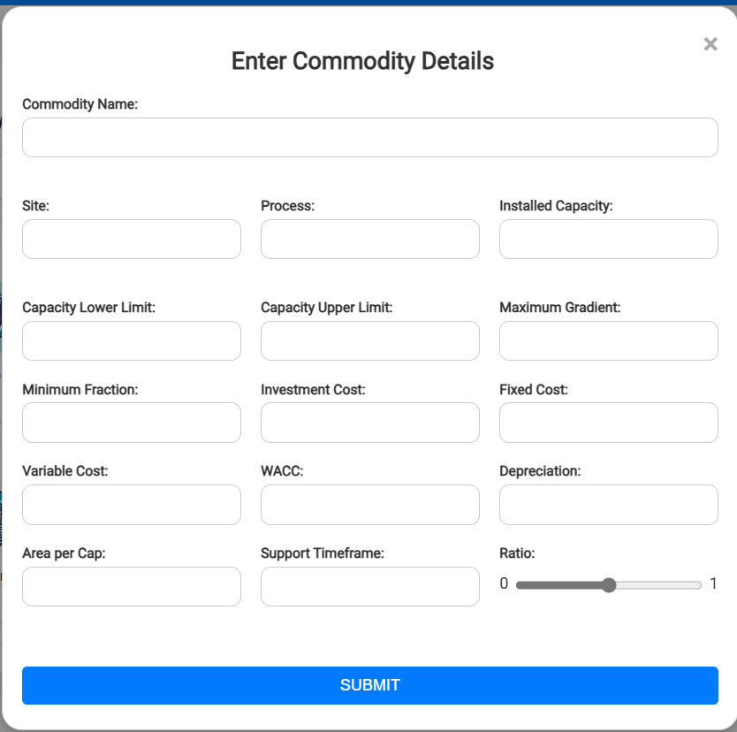
USER INTERFACE
Users can select processes at the site of interest using an intuitive drag-and-drop interface or can initiate their own process
Overview
Methodology
Summary

Slide 15
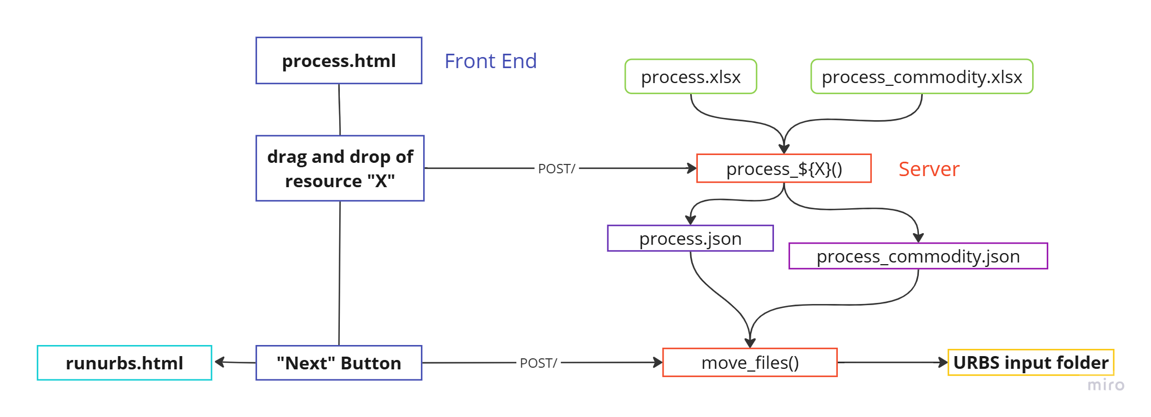
BACKEND AND GENERAL FUNCTIONING
Each Flask route function loads data from process.xlsx and processdemand.xlsx into Pandas DataFrames, extracts specific rows and append the data to JSON files.
Overview
Methodology
Summary

Slide 16
WEBSITE LOGIC
Overview
Methodology
Summary
Notes:
On the server part (green) the json files from the website (blue) are received and transformed so that the URBS algorithm con properly read in the data
Data from Renewable Ninjas is requested via an API (red)
User input (grey) comprises the location and optionally, timeseries for demand and discharge
After URBS has run successfully, the results are again uploaded to the Website

Slide 17
RUNNING URBS
Running
URBS
Overview
Methodology
Summary
Notes:
On the server part (green) the json files from the website (blue) are received and transformed so that the URBS algorithm con properly read in the data
Data from Renewable Ninjas is requested via an API (red)
User input (grey) comprises the location and optionally, timeseries for demand and discharge
After URBS has run successfully, the results are again uploaded to the Website

